Slide 1
WEB TECHNOLOGIES PORTFOLIO PRESENTATION

Slide 2
Introduction
Core technologies applied:
HTML (semantic structure)
CSS (layout and responsiveness)
JavaScript (interactivity and validation)
Multimedia and security awareness
Portfolio designed to evidence:
Progressive technical skill development
Critical understanding of web design principles
Assessment divided into:
Part A: Final integrated portfolio website
Part B: Weekly reflective evidence

Slide 3

Assessment Structure: Part A vs Part B
Part A – Final Portfolio Website
Fully functional portfolio website
Central navigation linking to:
  Six independently coded units
Focus on:
  Technical implementation
  Usability and responsiveness
  Code organisation and maintainability
Part B – Weekly Evidence
Structured weekly PDF reports
Screenshots demonstrating functionality
Reflection on:
  Tasks completed
  Challenges encountered
  Learning outcomes achieved

Slide 4

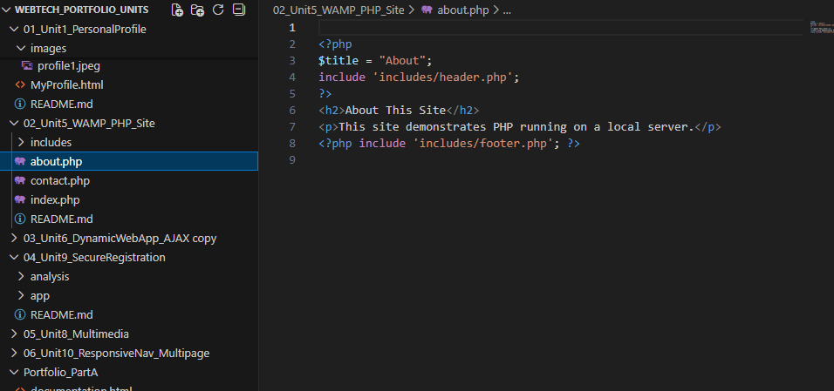
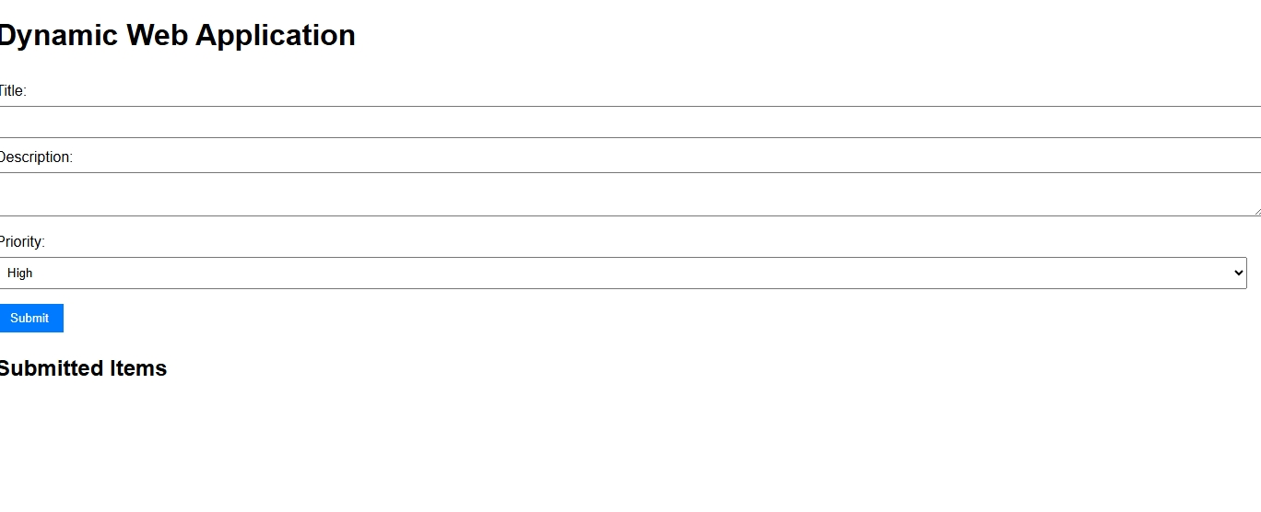
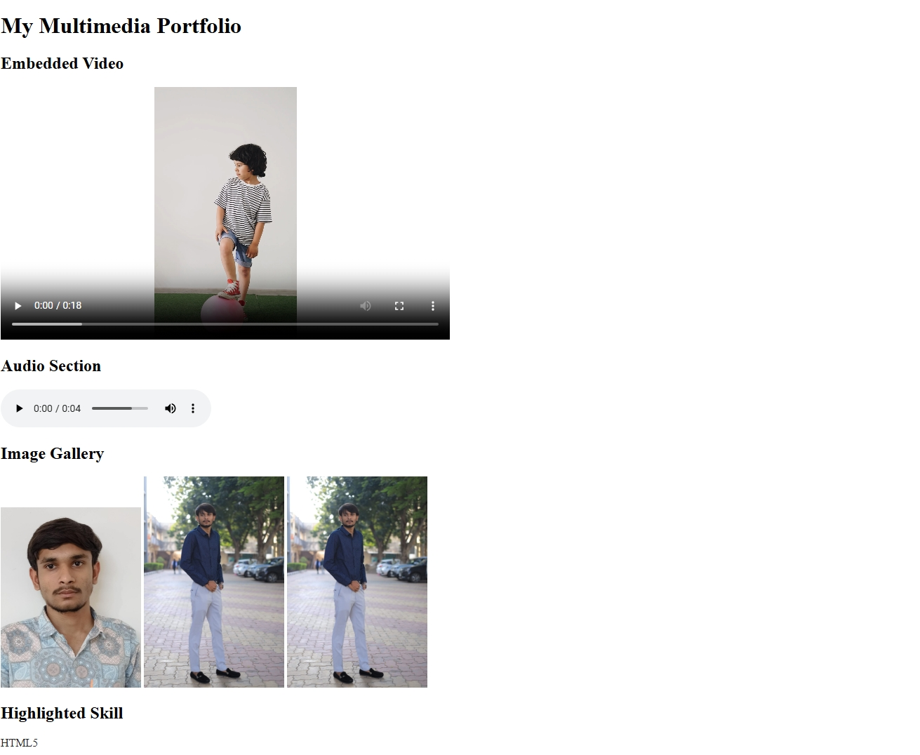
Weekly Learning Progression (Part B)
Week 1:
Semantic HTML structure
Content hierarchy and accessibility foundations
Week 4:
Introduction to server-side concepts
Local deployment using WAMP and PHP
Week 6:
Dynamic behaviour and form validation
Client-side interactivity using JavaScript
Week 8:
Multimedia integration (video, audio, images)
Performance-aware content handling
Week 10:
Responsive navigation
Security awareness and validation limitations

Slide 5
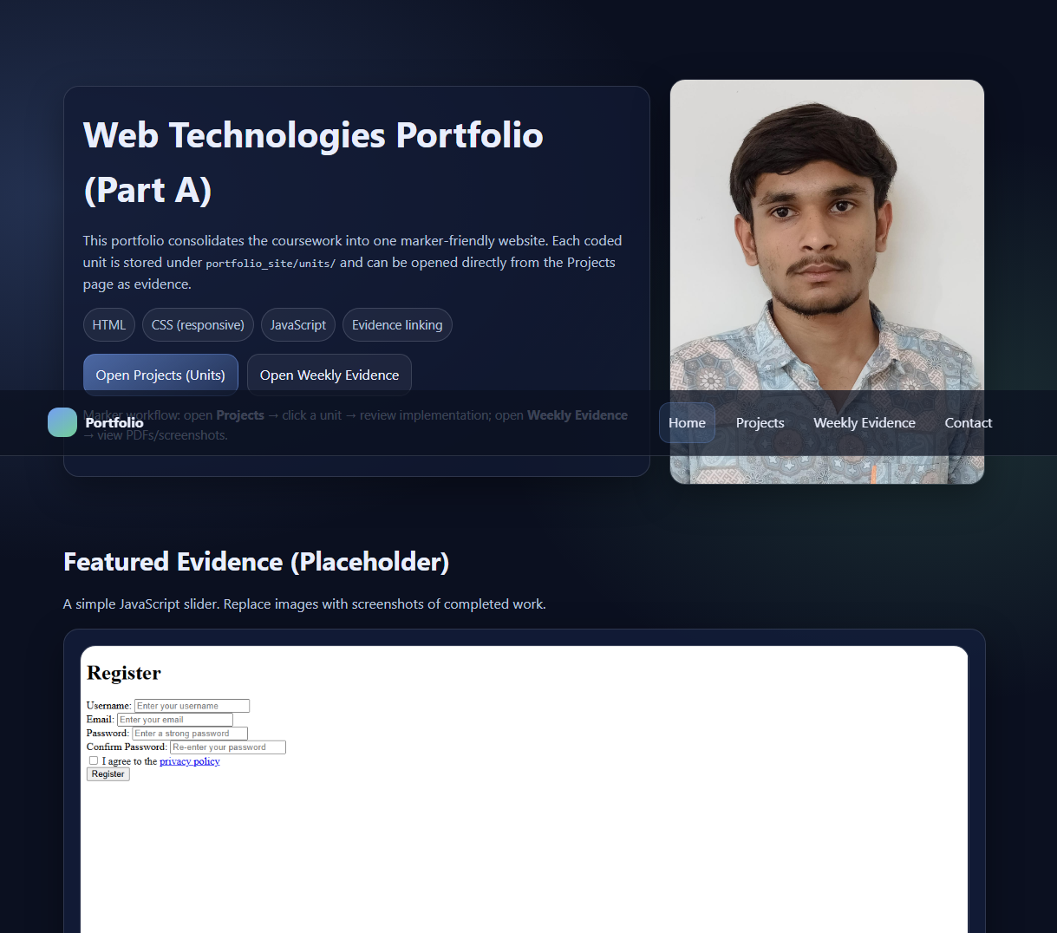
hTML and Semantic Foundations
Use of semantic HTML elements:
<header>, <nav>, <section>, <article>, <footer>
Clear content hierarchy using headings and lists
Separation of structure from presentation
Accessibility-aware design supporting:
Screen readers
Maintainable codebases
Semantic principles applied consistently across:
Unit 1 personal profile
Final portfolio pages

Slide 6
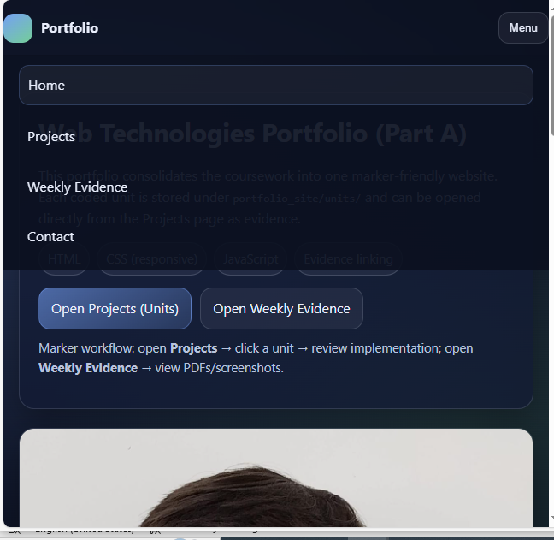
CSS and Responsive Design
Centralised CSS for:
  Consistent typography
  Spacing and alignment
  Visual hierarchy
Responsive layout techniques:
  Flexible containers
  Media queries
Navigation adapts to different screen sizes
Design prioritises:
  Readability
  Professional appearance
  Reduced cognitive load over visual complexity

Slide 7
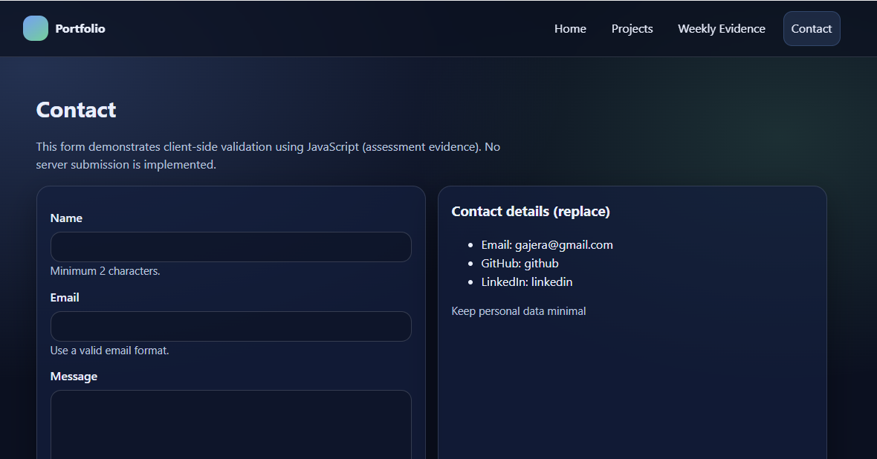
JavaScript and Interactive Features
JavaScript used for functional enhancement:
  Navigation interaction
  Form validation
  Dynamic content updates
Client-side validation provides:
  Immediate user feedback
  Improved usability
Dynamic behaviour implemented without page reloads
Explicit recognition of limitations:
  Client-side validation alone is insufficient for security
  Server-side controls required in real-world systems

Slide 8
Multimedia Integration
Integration of HTML5 multimedia elements:
  <video> for local video playback
  <audio> for embedded sound
  Image gallery for visual content
Multimedia used selectively to:
  Enhance engagement
  Support portfolio presentation
Performance considerations:
  Avoidance of excessive media
  Awareness of load time and device constraints

Slide 9
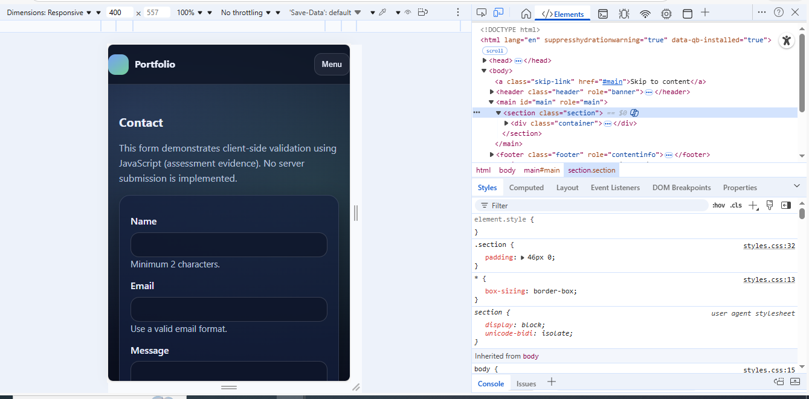
Testing, Reliability, and Debugging
Browser testing conducted across:
  Multiple modern browsers
Responsiveness tested using:
  Developer tools
  Simulated mobile and tablet viewports
Form validation tested with:
  Invalid inputs
  Edge cases
Debugging methods:
  Browser console
  Incremental code refinement
Acknowledged limitations:
  Manual testing only
  No automated or server-side testing

Slide 10
Learning Outcomes and Critical Reflection
Demonstrated progression from:
  Static HTML → dynamic → responsive systems
Improved problem-solving through:
  Debugging
  Iterative refinement
Increased awareness of:
  Accessibility
  Usability
  Security limitations
Portfolio aligns with:
  Professional web development practices
  Academic expectations for reflective learning
Static HTML
Dynamic
responsive systems

Slide 11
Conclusion and Future Development
Portfolio successfully demonstrates:
Technical competence
Structured design
Reflective understanding
Key strengths:
Semantic structure
Modular organisation
Effective interactivity
Identified limitations:
Lack of backend integration
Client-side-only validation
Future enhancements:
Database connectivity
Authentication systems
Automated testing
Portfolio represents a strong foundation for further professional development

